Slide 1
OFFICE OF THE CHIEF DATA OFFICER
Grow margin by knowing,
keeping & growing
your best customers
A customer & demand intelligence capability that turns transaction data into profit — with every play proven by experiment.
Retail customer-intelligence solution · outcome-focused

Slide 2
THE PROBLEM
Before: flying without instruments
No customer view
every shopper treated alike
Churn found too late
noticed only after they've gone
Marketing by gut
blanket discounts erode margin
Generic cross-sell
no 'what to offer next'
Reactive inventory
stockouts lose sale + basket
13% revenue invisible
guest sales untracked

Slide 3
THE SOLUTION
One capability, three questions answered
WHO
WHO'S LEAVING
WHAT TO OFFER
Segment customers
Spot leavers early
Recommend next product
6 behavioural groups; 17% drive 70% of revenue
flagged before they go, ranked accurately
personalised cross-sell, ~100× better than random
+ a demand forecast that sets profit-optimal stock, and a £-value model that ranks every lever.

Slide 4
BEFORE → AFTER
What changes when data leads
CAPABILITY
BEFORE
AFTER
Customer understanding
One-size-fits-all
6 segments, prioritised by profit
Churn
Found after they leave
Scored early — 250-name, £0.7M rescue list
Marketing spend
Blanket, gut-led
Profit-thresholded + proven by control group
Cross-sell
Generic
Personalised next-best product
Inventory
Reactive
Forecast + margin-aware stocking
Guest revenue
13% invisible (£2.6M)
Sized & converted via loyalty

Slide 5
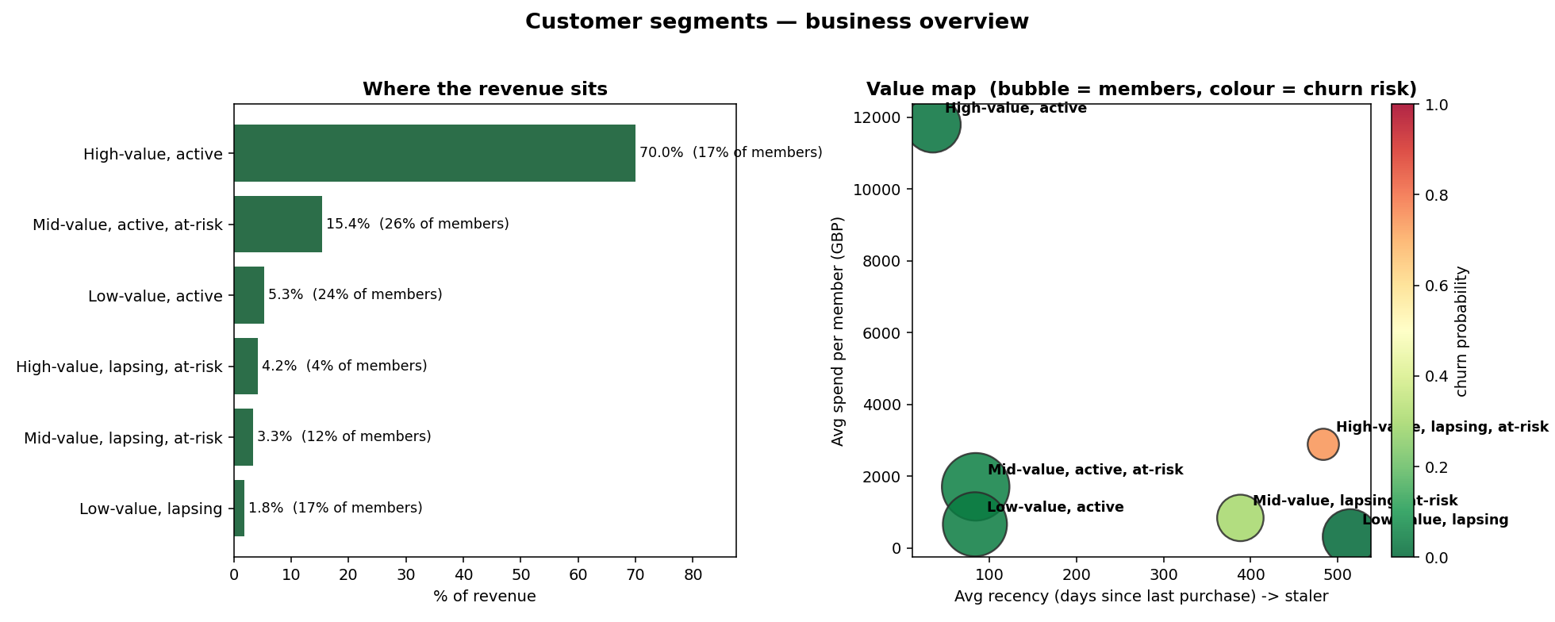
THE PLAYS
Where the money is: Protect · Rescue · Grow
PROTECT — 70% of revenue, ~2% churn. Defend with loyalty & service, not discounts.
RESCUE — 250 high-value lapsing, ~£0.7M at risk. One-time win-back, proven by control.
GROW — 1,545 mid-tier with headroom. Cross-sell to lift ARPU at the profit-optimal threshold.
Loyalty also converts the £2.6M anonymous Non-Member base into tracked members.
Segments by revenue and by value/risk.

Slide 6
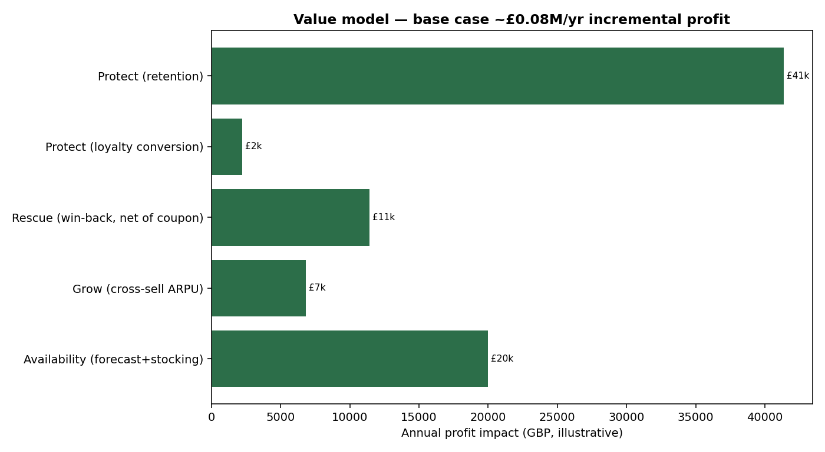
THE OUTCOME
Levers priced — and proven before we scale
Estimated ≈ £82k/yr incremental profit (base), scaling linearly with revenue.
Retention is the single biggest lever.
Transparent assumptions + sensitivity (margin, uplift).
Each play runs behind a holdout control — we measure lift, not assume it.

Slide 7
HOW I WORK
Honest, business-first, evidence-led
Business leads, technology serves — every model maps to a profit decision.
Money on the metrics — results in £, not just model scores.
Proven, not promised — controlled experiments before spending at scale.
Candid about limits — assumptions stated, simple baselines respected.
Reproducible — clean code, a warehouse, and documentation that doesn't drift.

Slide 8
What I can do for you
Stand up customer segmentation, churn early-warning, and cross-sell engines.
Turn your transaction data into ranked, costed, experiment-backed growth plays.
Deliver it reproducibly — warehouse, models, and an executive narrative leaders trust.
Let's talk about your data → profit roadmap.

